Slide 1

Click here to download the software
BioTime 9.5
Web-based Multi-location Centralized Time and Attendance Software
Contact us: zk_me@zkteco.com • www.zkteco.me
Updated: 08 October 2026

Slide 2


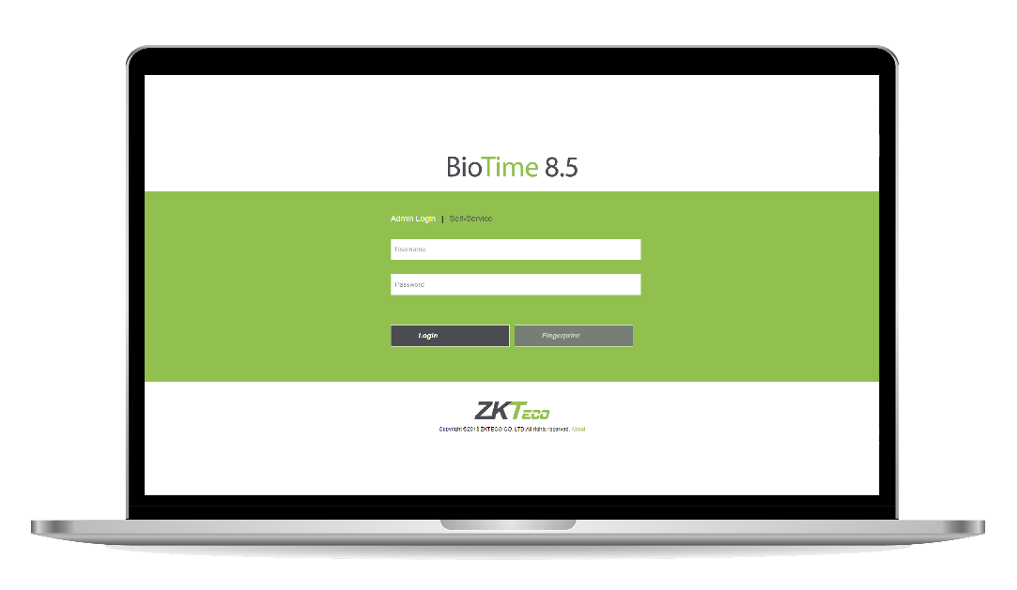
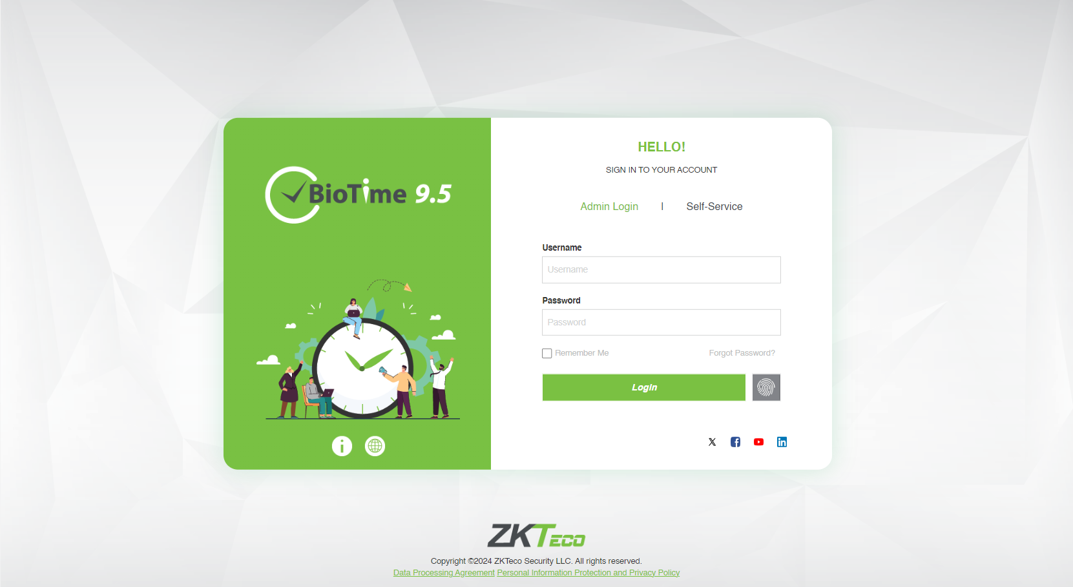
What is BioTime?
BioTime 9.5 is a powerful time and attendance management platform designed for medium to large enterprises. It maintains a stable connection with thousands of ZKTeco standalone push communication devices through Ethernet, WIFI, and 4G networks.
It operates as a private cloud system, enabling employees to access self-service features through both the mobile application and web browser, ensuring flexibility, scalability, and effortless workforce management.
BioTime 9.5 features an intuitive and modern user interface that simplifies daily workforce management. The system efficiently handles timetables, shifts, and schedules, and can quickly generate up to 31 types of comprehensive attendance reports. It has a modern dashboard where users can monitor attendance summaries, real-time punches from all connected devices, device connectivity and status, attendance insights, and much more.
It includes roster and overtime management which simplifies the entire scheduling workflow of employees. With its built-in API, BioTime 9.5 can easily integrates with third-party HR and payroll systems, ensuring smooth data exchange across platforms.
Click here to download the software

Slide 3
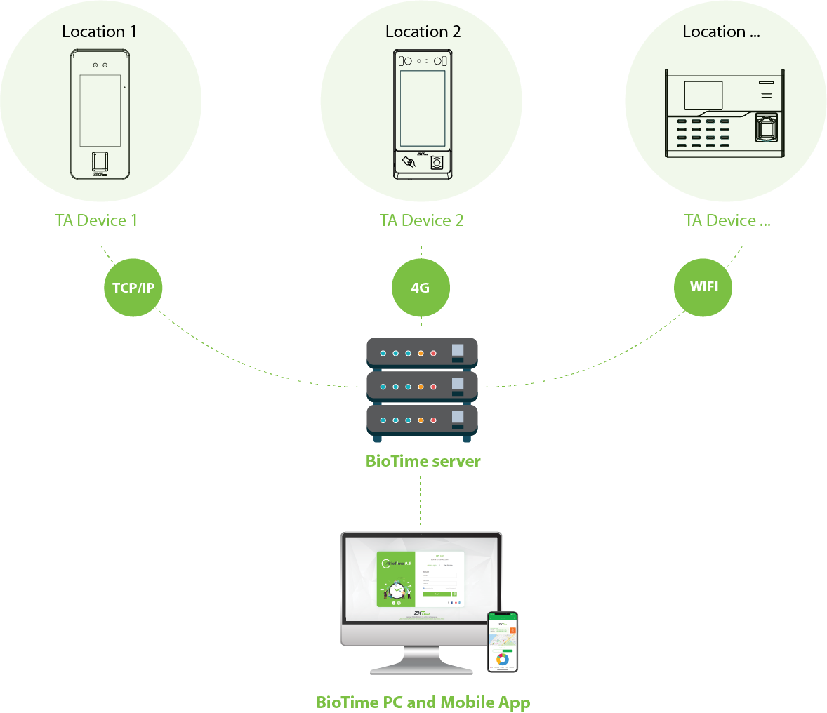
System Architecture
ü
Supports up to 500 devices in a single server
ü
Multiple administrator and employee self-logins
ü
Synchronize data from different locations
ü
Flexible database compatibility
ü
API compatibility for easier integrations
ü
Centrally manage roster, shifts, and timetables
ü
Monitor the data from inter-regional terminals in real-time
Click here to download the software

Slide 4

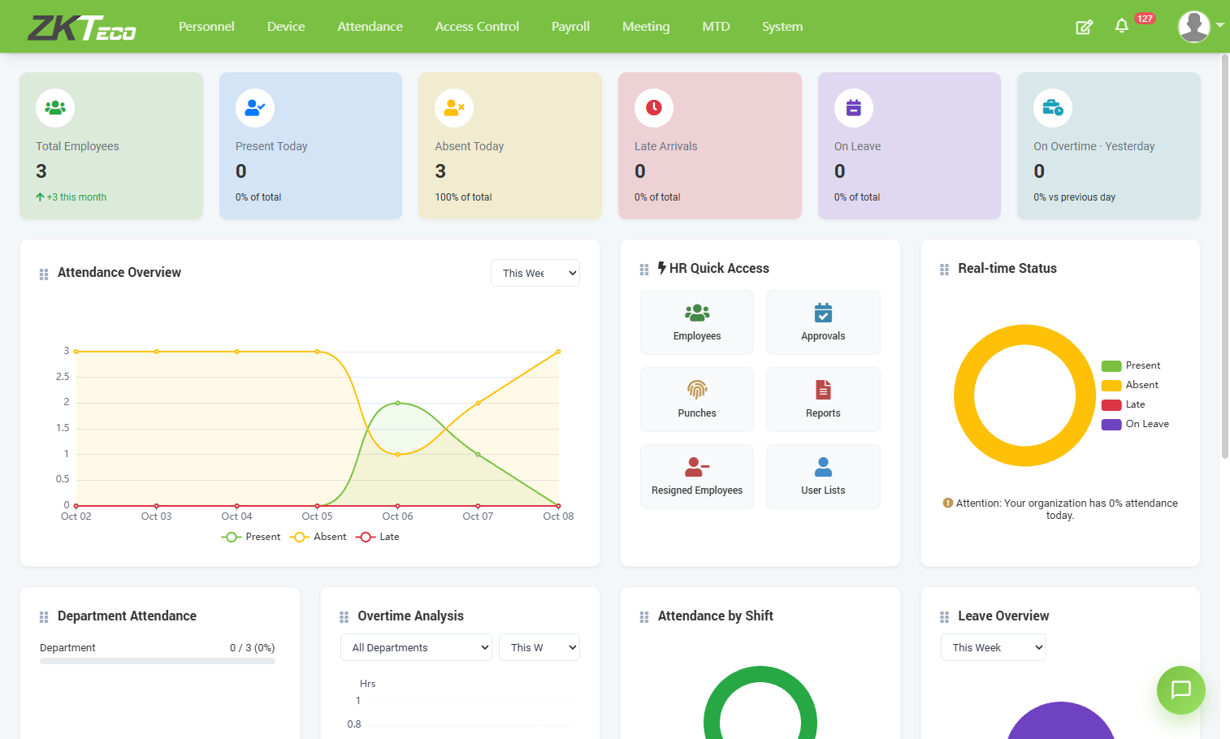
Analytical Dashboard
Personalized Dashboard
Users can personalize the dashboard widgets allowing them to see the most important widgets first. It gives a quick view of attendance summaries and schedules.
BioTime Assistant
Enables users to interact with the system providing instant access to attendance data, workforce insights.
HR Overview
Displays attendance insights and quick access to employee data
Real-Time Monitoring
Real-time attendance logs with geographic location
Click here to download the software

Slide 5















Main Features
New
BioTime Chat Assistant
Provides an intelligent and interactive way to access workforce management information. Users can ask questions related to attendance records, leave balances, overtime data, schedules, and workforce trends.
New
AI Attendance Summary and AI Insights
The AI engine highlights anomalies and actionable insights such as high late arrival patterns, attendance trends, and smart recommendations, etc.
New
Modern Dashboard
Displays summary cards, attendance overview, HR quick access and overview, attendance analysis, real-time monitoring, announcements, and AI attendance insights.
Roster and Leave Balance Management
Auto-synchronization of Biometric Templates
Simple Access Control Module
Multiple Kinds of Shift Scheduling
Meeting Management
Basic Payroll Management
WhatsApp Notification
Visitor Management
Geofencing Mobile Application Punches
Integration with Third-Party HR and ERP software (SAP, Oracle, Odoo, etc.)
Multiple Level Approval
Up to 30+ types of Attendance Reports
Overtime Calculation
Auto Export of Attendance Report
Database Backup and Restore
Click here to download the software

Slide 6
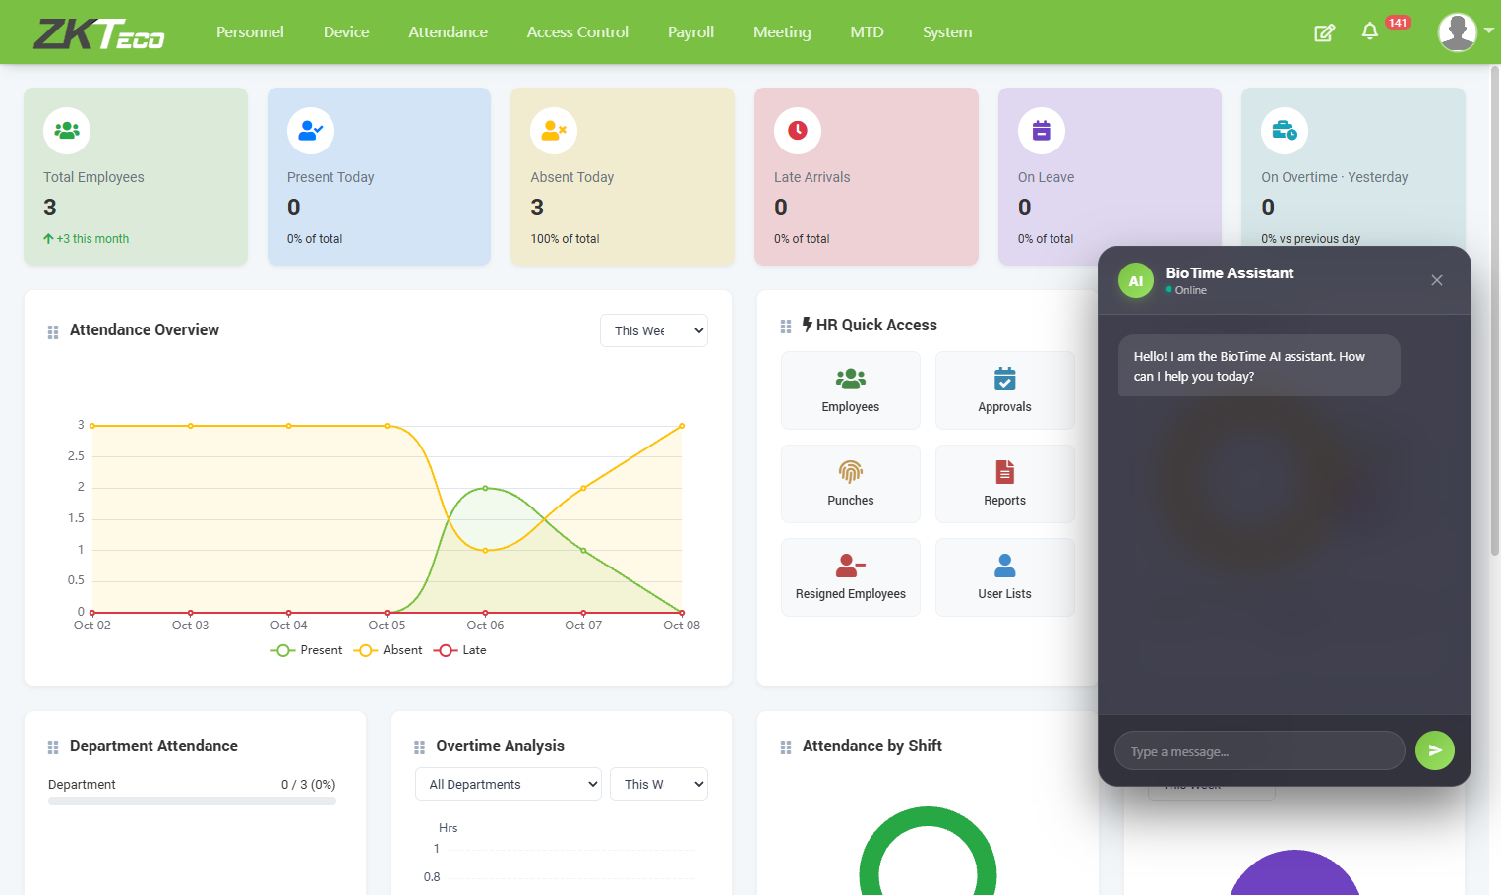
Main Features
BioTime Chat Assistant
The BioTime Assistant provides an intelligent and interactive way to access workforce management information.
Users can ask questions related to attendance records, leave balances, workforce trends, etc., while AI delivers instant insights, summaries, and recommendations to improve decision-making and operational efficiency.
Note: Basic BioTime AI Chatbot Assistant features are available. For optimal AI response quality, performance, and processing efficiency, please contact our support team.
Click here to download the software

Slide 7
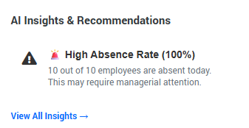
Main Features
AI Attendance Insights and Recommendations
Automated anomaly detection — Identifies irregular attendance patterns such as high late arrival, high absence rate, missing punches, etc.
Helps HR or administrators anticipate attendance issues and optimize scheduling efficiency.
Click here to download the software

Slide 8
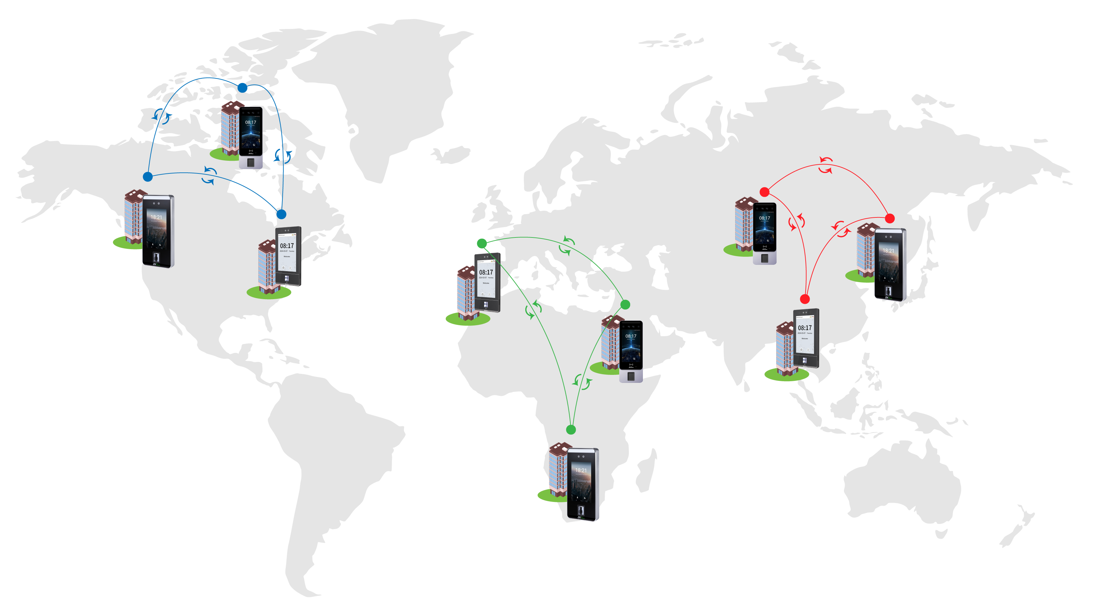
Main Features
Auto-sync of Biometric Templates and Data
Area 1
Area 3
Area 2
BioTime automatically synchronizes data between devices and the server within the same “Area,” ensuring all attendance information remains consistently updated and accurate.
Devices and personnel assigned to the same “Area” automatically stay synchronized, ensuring their attendance data, status, and updates remain consistent across the system.
Click here to download the software

Slide 9
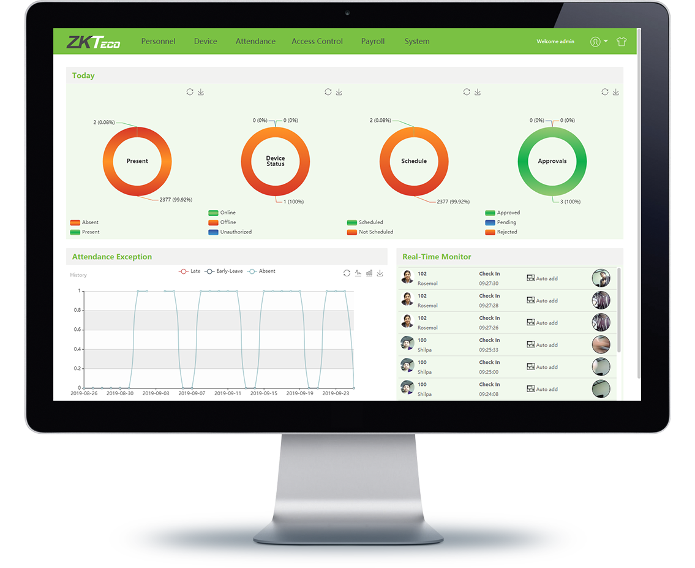
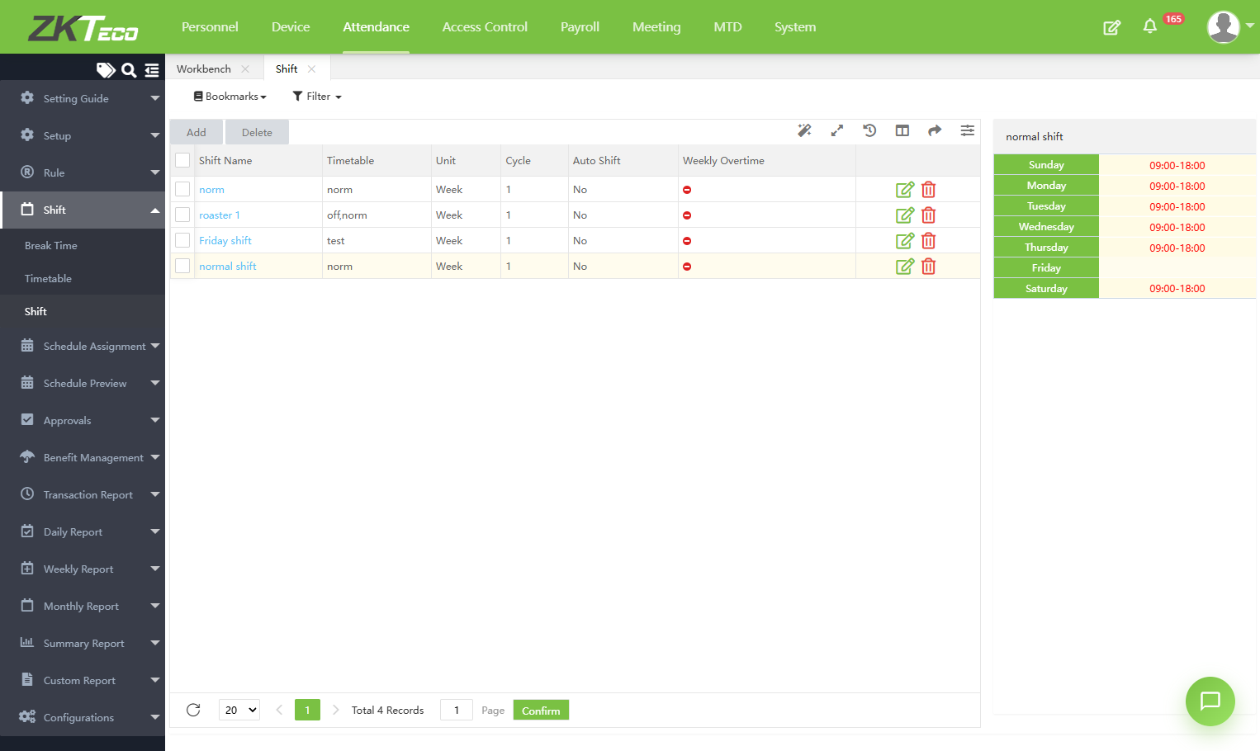

Main Features
Flexible Shift Scheduling
Multiple Timetables - Manage different work time structures
Cross-day Shift - Support 24-hour or overnight shifts
Shift Cycle - Automate repeating shift patterns
Auto shift - Auto-assign shifts based on punches
Temporary schedule - Short-term schedule changes
Group schedule - Assign schedules to groups
Department schedule - Department-level scheduling
Employee schedule - Individual schedule assignment
Click here to download the software

Slide 10
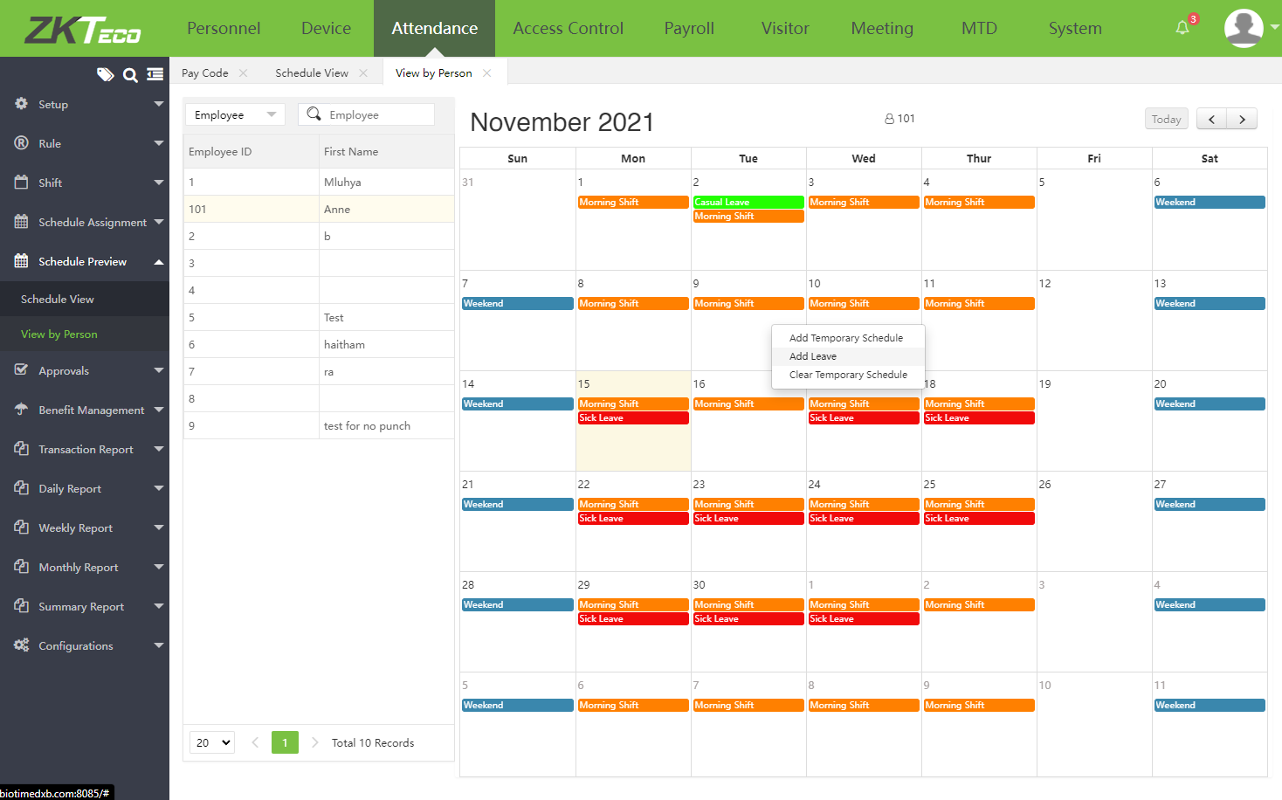
Main Features
Roster and Leave Balance Management
Roster Management
Efficiently plan, assign, and adjust employee rosters across departments and Areas
Leave Balance
Track leave entitlements, remaining balances, and approvals in real-time
Schedule in Calendar View
Administrators can quickly manage schedules by clicking directly on the dates, making calendar-based scheduling simple and intuitive for employee schedules, department schedules, and group scheduling.
Click here to download the software

Slide 11
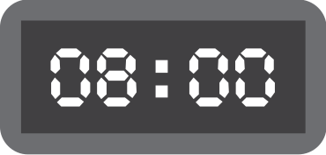


Main Features
Overtime Management
Overtime management automatically handles overtime calculation, provides real-time overtime status, and applies custom overtime rules. Managers can review hours through a simple approval workflow and access clear overtime cost visibility for better planning.
Example 1
WORKING SCHEDULE HOURS
NORMAL HOURS
OVERTIME 1
TOTAL HOURS
Salary per day
+
USD 20
8 hours
+
=
2 hours
(USD 10 per hour)
10 Hours
Example 2
WORKING SCHEDULE HOURS
NORMAL HOURS
OVERTIME 1
OVERTIME 2
TOTAL HOURS
Salary per day
+
USD 60
8 hours
+
+
=
2 hours
(USD 10 per hour)
2 hours
(USD 20 per hour)
12 Hours
Click here to download the software

Slide 12
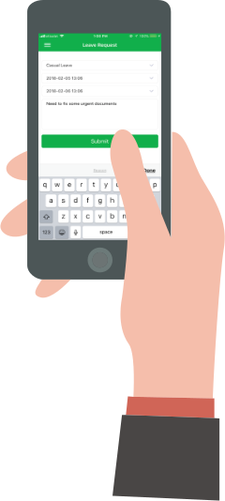



Main Features
Multi-level Approval Workflow
Employees can apply for leave, manual punch, early leave, or training through BioTime software or BioTime mobile application which can be approved by Approvers who are set on hierarchal level.
FINAL APPROVAL
Manager
Senior Manager
General Manager
Employees apply for leave, manual punch, and training
Requests will go through approval by the approvers.
Click here to download the software

Slide 13
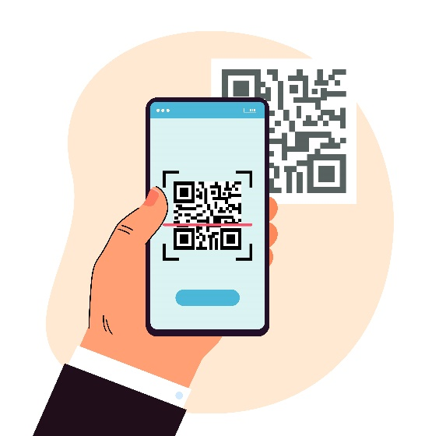

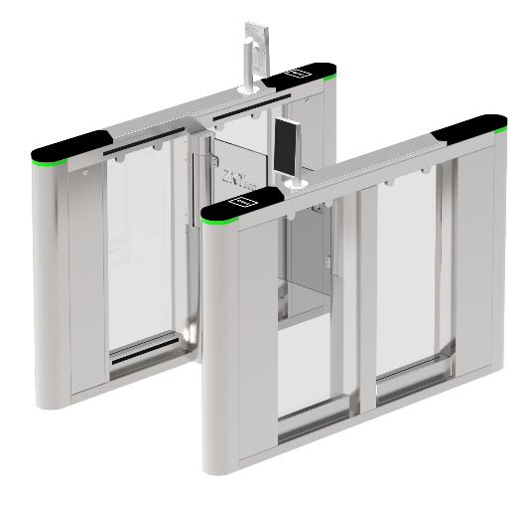
Main Features
Bio Photo Registration Function
The Bio photo function allows users to register their face and other credentials directly from a mobile device, providing fast and convenient mobile enrollment.
Scan the QR code to access the registration process.
Register your face using your mobile phone.
Enter the perimeter by verifying your face.
Note: Bio Photo function works only with visible light facial terminals.
Click here to download the software

Slide 14
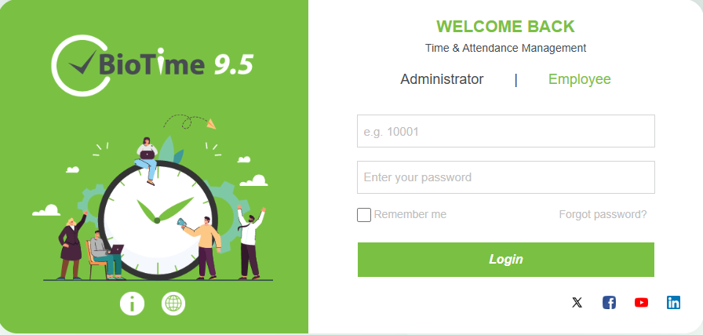

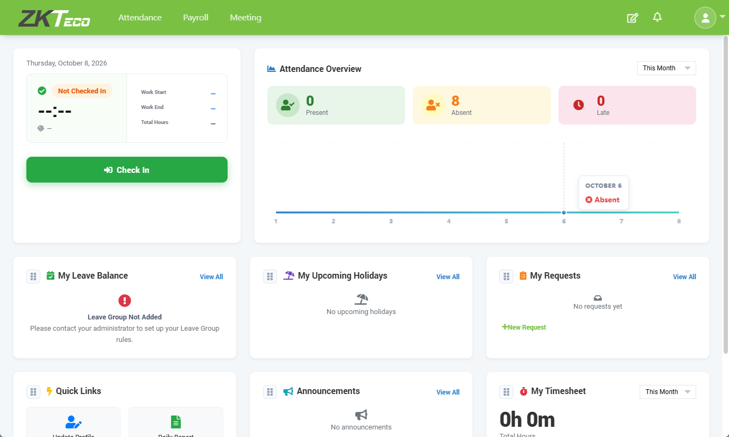
Main Features
Employee Self-Service Log-in
Access login is provided for each employee, allowing them to manage their attendance, payroll, visitor settings, and meeting settings directly through their own account.
Employees can also apply for leave, training, manual punch, overtime, and schedule changes online, with all requests routed to the manager or admin for approval.
Click here to download the software

Slide 15
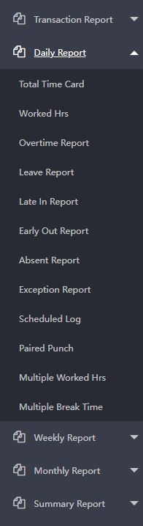
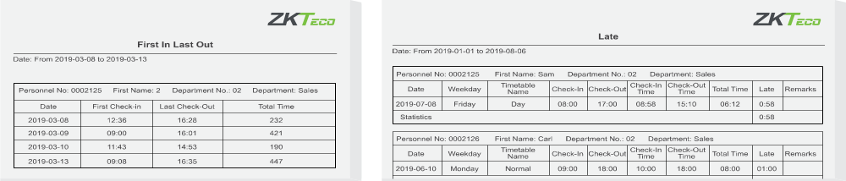
Main Features
Attendance Calculation and Report Generation
Example Report 1
Generates up to 30 types of attendance reports that can be exported to CSV, PDF, or XLS formats for flexible data analysis and sharing.
Example Report 2
Click here to download the software

Slide 16
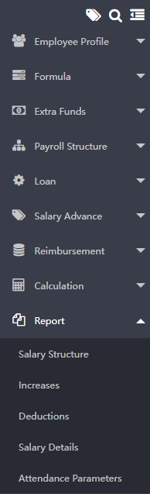
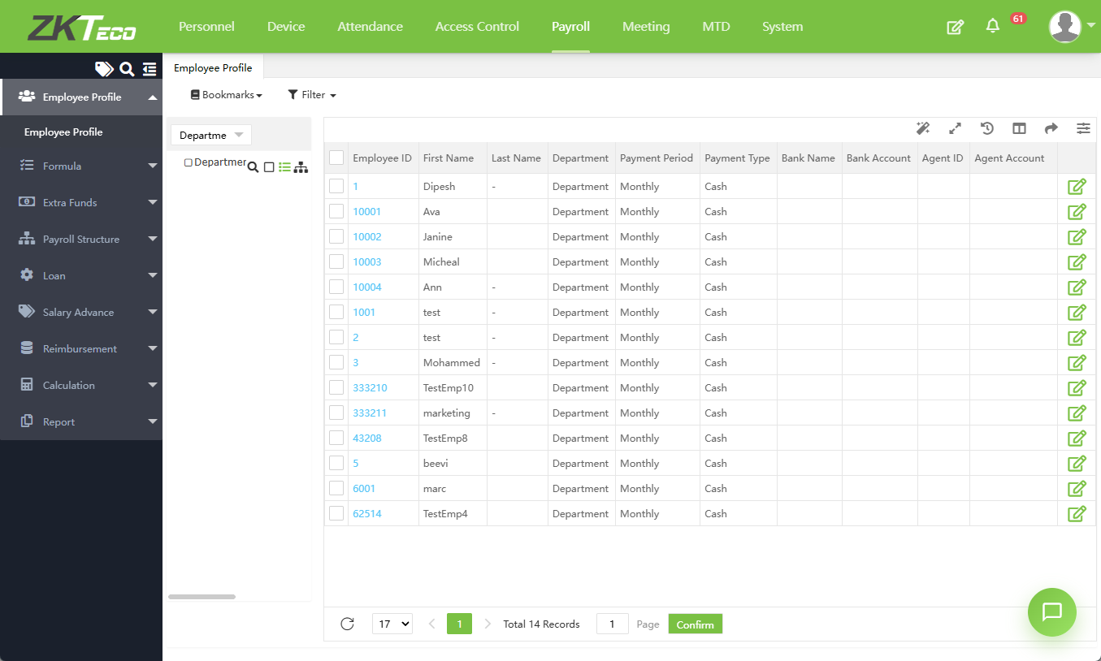
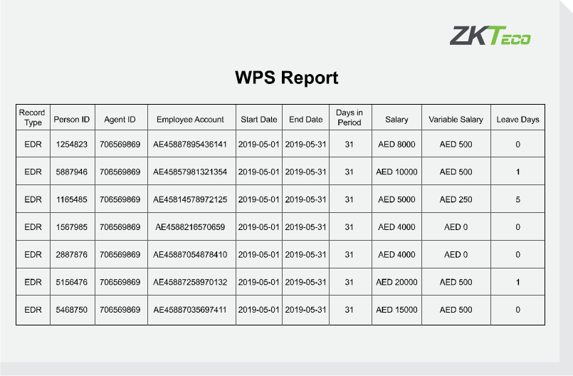
Main Features
Basic Payroll Management
Manage payroll structures and generate various kinds of payroll reports.
Click here to download the software

Slide 17





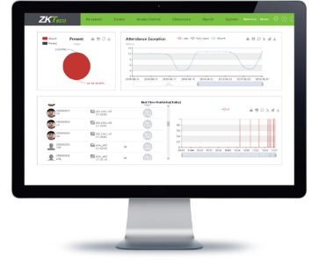
Main Features
Integration with 3rd Party Software and Database Migration
BioTime provides a standard API integration for connecting with third-party software. Several supported integrations are listed below, and if you are using other ERP or HR platforms, please ZKTeco for more information about custom integration options.
The logos and trademarks presented in this slide are the property of their respective owners. Their inclusion here does not imply any endorsement, sponsorship, or affiliation with the owners of these logos. They are used solely for illustrative purposes to refer to the entities that own these trademarks. All rights to these logos and trademarks remain with their respective owners.
Database Migration
Allows the user to upgrade the old version to the new version of the software through built-in upgrade operations for a smooth and hassle‑free update process.
Old Software Version
New Software Version
Migration
Click here to download the software

Slide 18
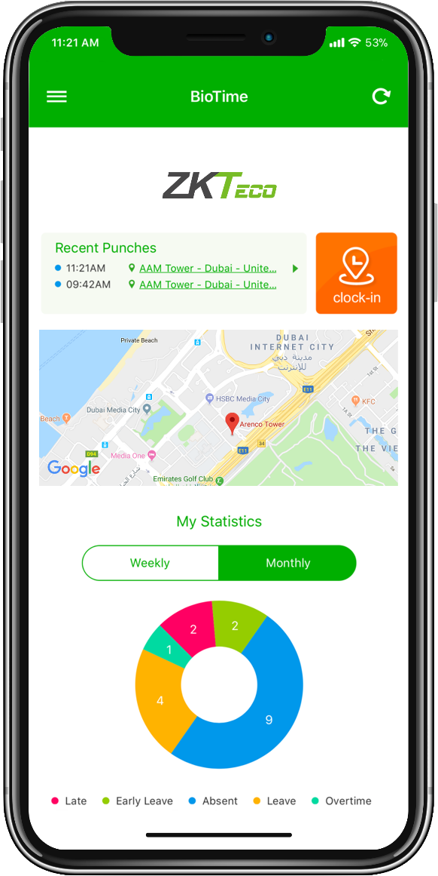


BioTime Mobile Application
Features:
Real-time attendance with geographic location details
Attendance approvals
Real-time notifications
Public and Private Announcements
Easy operation: Two-step navigation
User-friendly interfaces for admin and employees
Online employee requests and status
Available in:

Slide 19
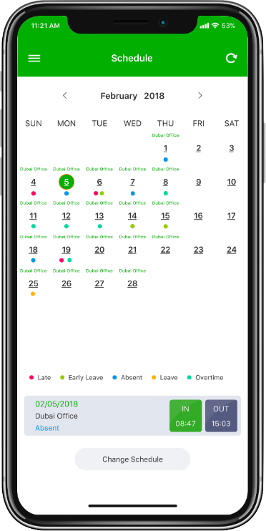
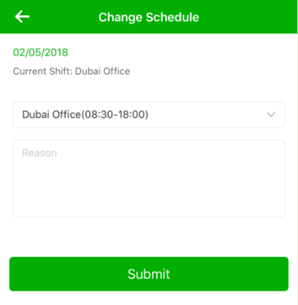
Mobile Application Features: Schedule Assignment
This interface provides easy access for employee requests such as leave, overtime, manual punch, and more.
It also displays the status of each request across multi-level approvals for clear and transparent tracking.
Employees can request a change to their assigned schedule online, and each schedule change request is routed to the designated admin or approver for review and approval.

Slide 20
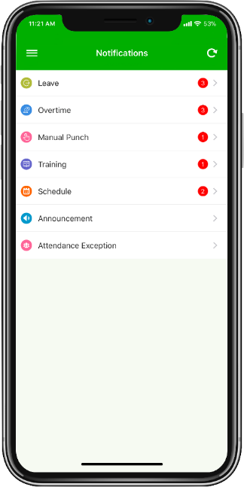
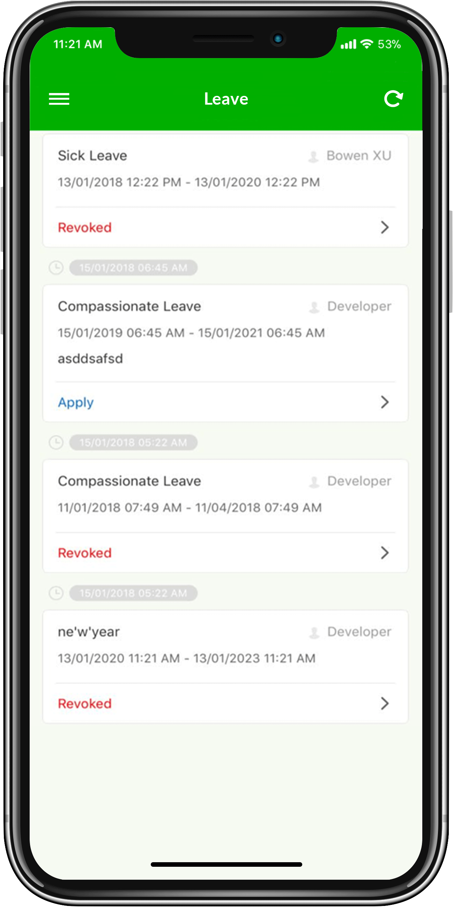
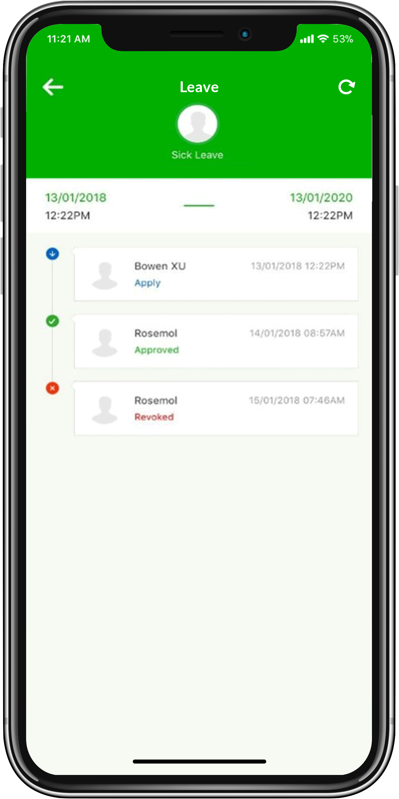
Mobile Application Features:
Online Employee Request
This interface provides easy access for employee requests such as leave, overtime, manual punch, and more. It also displays the status of each request across multi‑level approvals for clear and transparent tracking.

Slide 21
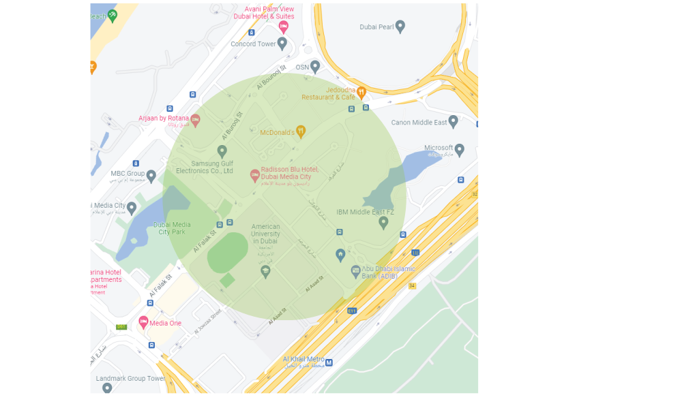
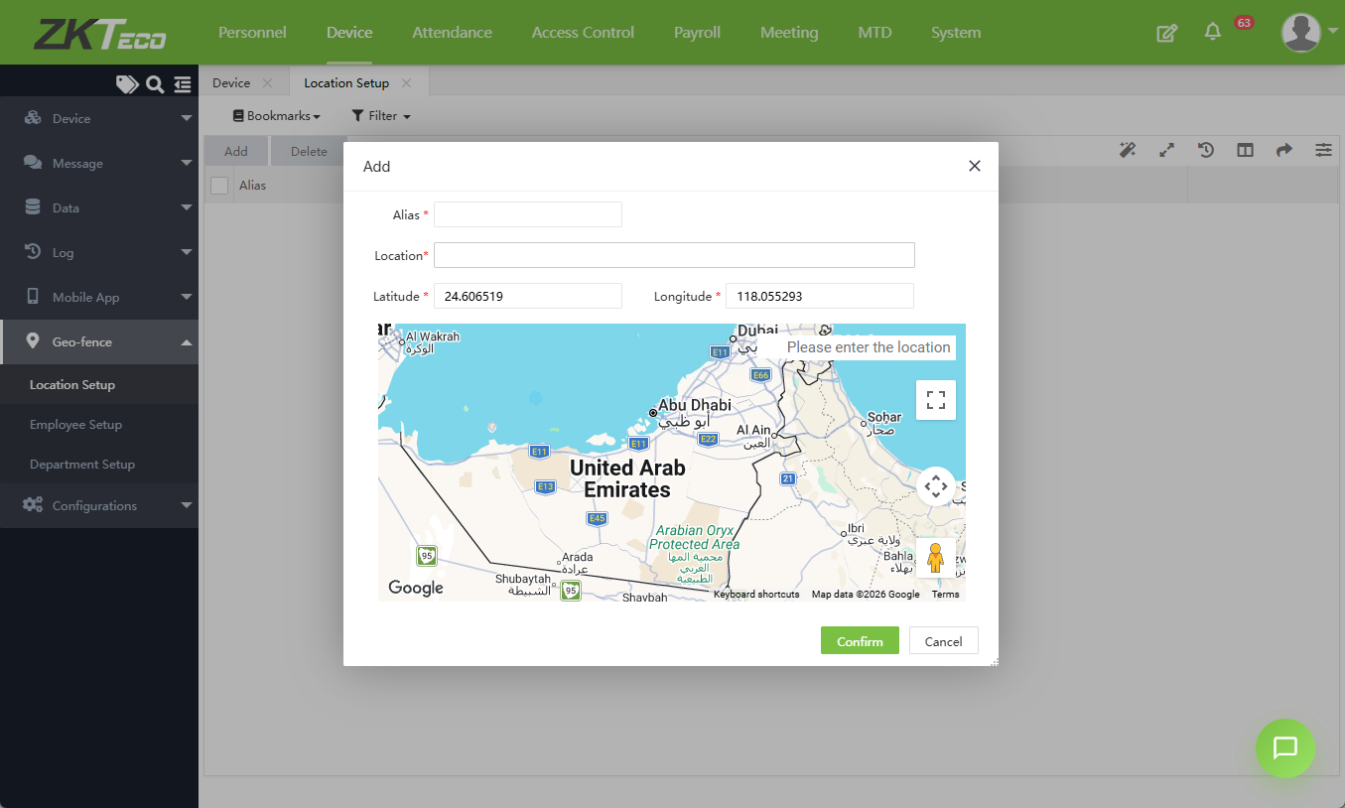
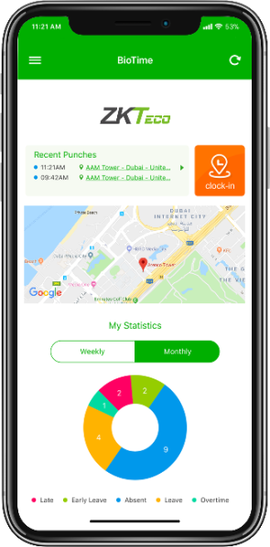
Mobile Application Features:
Geofencing Mobile Punches
Creates geographic boundaries to restrict mobile application punches by defining clock-in boundaries within the BioTime software. These geofencing rules ensure employees can only perform mobile punches inside authorized locations for accurate and secure attendance tracking.
Clock-in
Not Allowed
Allowed
Clock-in
Clock-in
Allowed
Not Allowed
Clock-in

Slide 22
Specifications
Software Specifications
System Architecture | Web-based software
Suggested Devices | Standalone devices with Attendance PUSH & Green Label Series (please refer to the Hardware Suggestion List)
Authentication Options | Fingerprint / Face / Palm / RFID / Password
Max. Supported Devices | 500 devices in a single server (please contact ZKTeco for more information on capacity expansion)
Database | PostgreSQL (Default), MSSQL Server 2017/2019, MySQL 7.0 or above, Oracle 19c
Supported OS | Windows Server 2016/ 2019/ 2022, Windows 10/ 11
Suggested Browsers | Chrome 33+, IE 11+, Firefox 27+
Minimum Server Hardware Requirements
CPU | Dual Core Processor with speed of 2.4GHz or faster
RAM | 4GB RAM available or above
Storage | 100GB available space or above (We recommend using NFTS hard disk partition as the software installation directory)
Display Resolution | 1024*768 or above
*It is recommended to use different server for database.

Slide 23

























Successful Projects

Slide 24
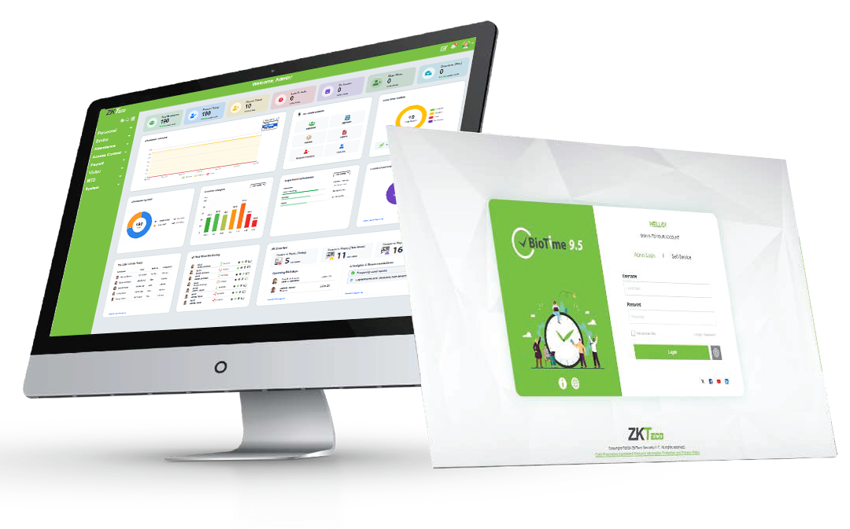

Explore BioTime now.
Discover and test the full features right in your browser.
Click Here
Username: admin
Password: admin
Like what you see? Contact us for the pricing zk_me@zkteco.com

Slide 25


Thank you.
If you have any questions, you may reach us at:
ZKTeco Middle East
P.O. Box 4323, Office 502 & 503, Bay Square Building 1,
Business Bay, Dubai, U.A.E.
Tel No.: +971 4 3927649
E-mail: zk_me@zkteco.com
www.zkteco.me
Scan to know more about us

