Slide 1

BioTime 8.5
Multi-Location Centralized Time Management System
Updated: 15 Jul 2021
Updated: 18 September 2019

Slide 2

BioTime 8.5 is a powerful time attendance software that provides a stable communication of up to thousands of time and attendance devices which can be remotely managed anywhere by accessing the software using a web browser.
The latest version is equipped with new competitive functions such as roster and overtime management which simplifies the entire scheduling process of employees, built-in API to connect on client’s 3rd-party software, database migration, bio photo, and geofencing mobile punches.
BioTime 8.5 also features a new dashboard where users can easily monitor all attendance summary, device’s status, request approvals that are approved, rejected, and pending, and real-time punches.
BioTime 8.5 gives the user full access and control in managing timetable, shift schedule, generating attendance reports, and more.
BioTime 8.5
BioTime 7.0

Slide 3

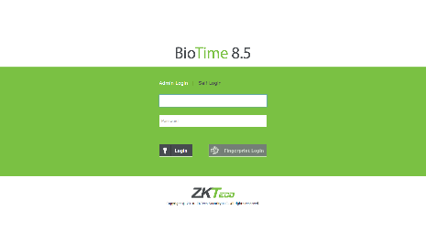
NEW DASHBOARD
Monitor all attendance summary in one page
OVERTIME MANAGEMENT
Multiple overtime levels that
can be set to employees
for payroll calculations
ROSTER MANAGEMENT
Administrator can easily manage
multiple schedule assignments
using excel import
BIOPHOTO FUNCTION
Enables to register a user
using mobile. This function is
designed for visible light
facial terminals only.
WHATSAPP NOTIFICATIONS
WhatsApp notifications for
attendance exceptions and
punch alerts.
GEOFENCING MOBILE PUNCHES
Creates a geographic boundaries
to restrict mobile application
punches
DATABASE MIGRATION
Allows the user to upgrade
the software easily by inbuilt
operation
INTEGRATION WITH API
BioTime 8.5 has a standard
API for third-party software
integrations

Slide 4

FEATURES
Web-based time attendance software
Simple access
control module
Payroll management
and WPS report
Auto-synchronization of
biometric templates
Multi-level approvals and automatic e-mail alerts
Flexible shift scheduling and cross-day shift
Real-time data transmission
Employee self-service
Multiple administrator
privilege
Supports multiple
languages
Attendance reports and calculation
Mobile application

Slide 5



WEB-BASED TIME ATTENDANCE SOFTWARE
Automatically transferring all data from device to the server
Remotely manage thousands of T&A terminals under complex network condition (WLAN)
Easy to set timetable and shift, assign work schedule, generate reports, etc.
Multiple administrator can access the web-based system anywhere using a web browser

Slide 6
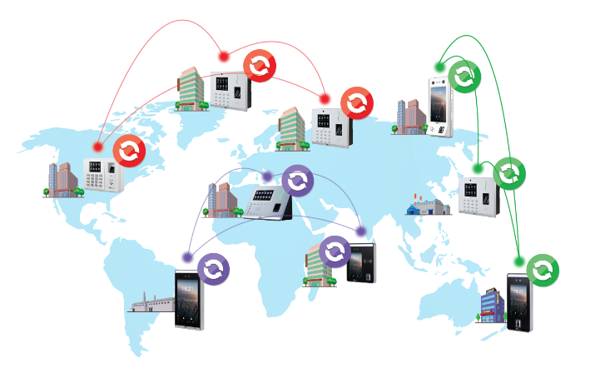
AUTO-SYNC OF BIOMETRIC TEMPLATES
Area 3
Area 1
Automatically synchronizing the data between devices and server among the same “Area” to ensure the information are updated.
Devices and Personnel in the same “Area” will keep data synchronization.
Area 2

Slide 7
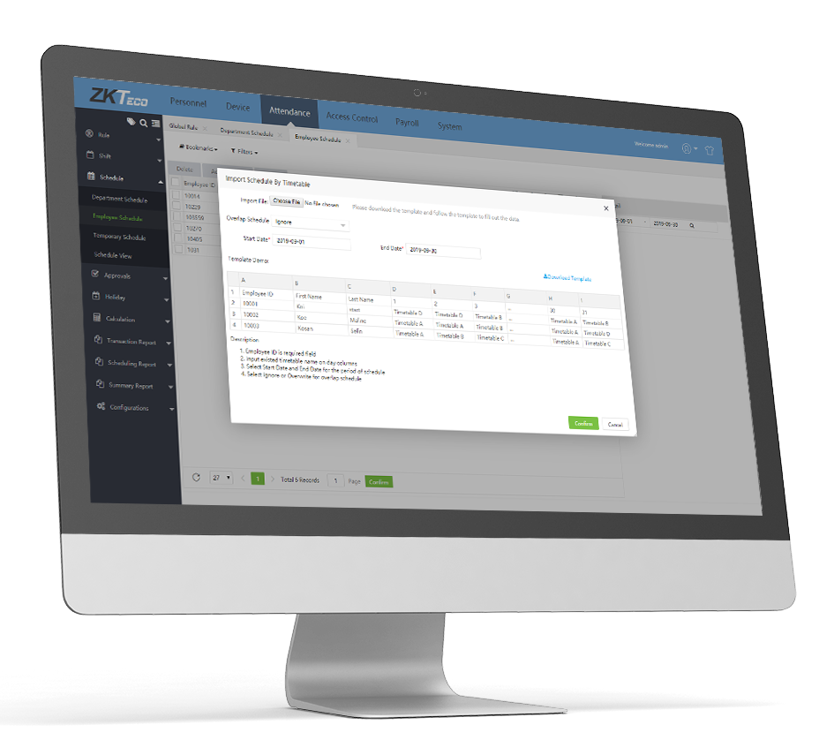
NEW
ROSTER MANAGEMENT
Easily manage multiple schedule assignments using excel import.

Slide 8
NEW
OVERTIME MANAGEMENT
1
2
SCHEDULE HOURS
SCHEDULE HOURS
NORMAL HOURS
OT 1
TOTAL HOURS
NORMAL HOURS
OT 1
OT 2
TOTAL HOURS
8 hours
8 hours
+
2 hours
$10/hour
=
10 hours
+
2 hours
$10/hour
+
2 hours
$20/hour
=
12 hours
Salary/day + $20
Salary/day + $60

Slide 9
NEW
WHATSAPP NOTIFICATIONS
WhatsApp notifications can be configured in the BioTime 8.5 for employees to receive attendance exceptions and punch alert notifications.

Slide 10

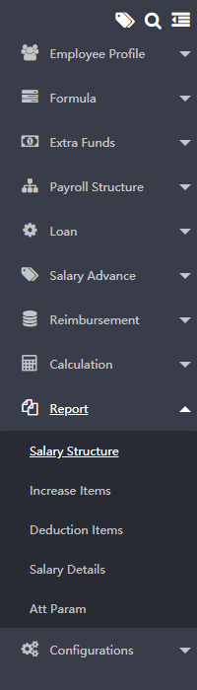
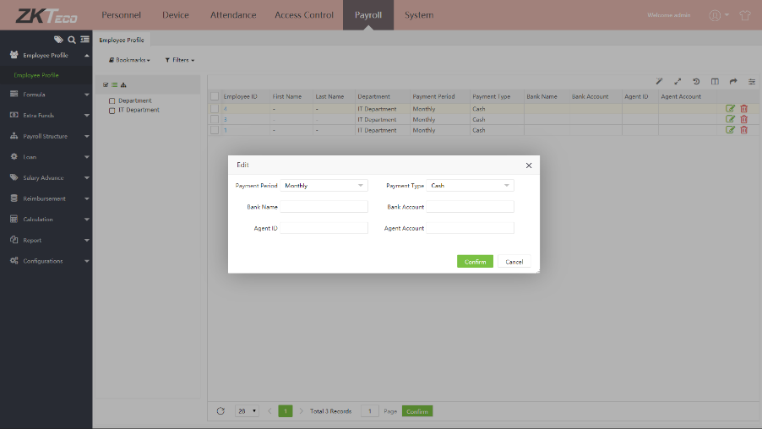
PAYROLL MANAGEMENT AND WPS REPORT
Generates more than five (5)
kinds of payroll reports

Slide 11
MULTI-LEVEL APPROVALS
Employees can apply for leave, manual punch, early leave, or training through BioTime 8.5 software or mobile application which can be approved by Approvers who are set on hierarchal level.
Apply for leave, manual punch, and training.
Requests will go through approval by approvers.

Slide 12
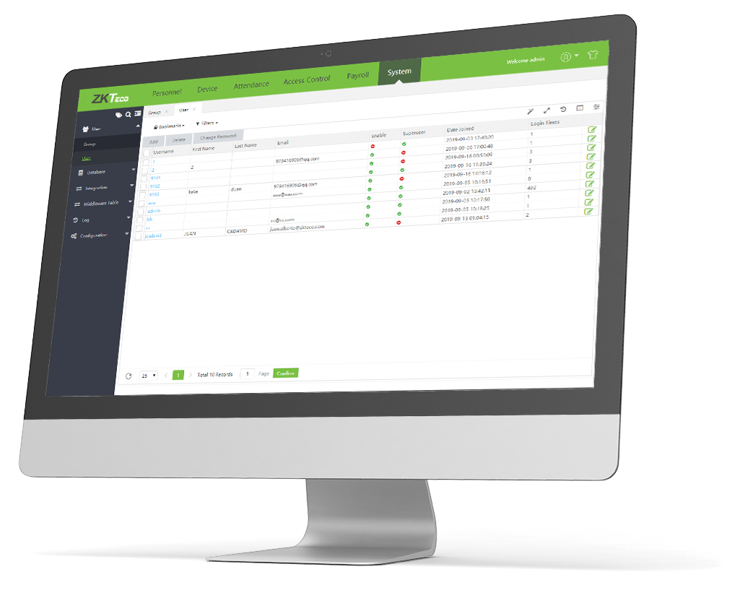
AUTOMATIC E-MAIL ALERTS
E-mail notifications are sent to employees for attendance alerts in case of late, early leave, and absence.

Slide 13
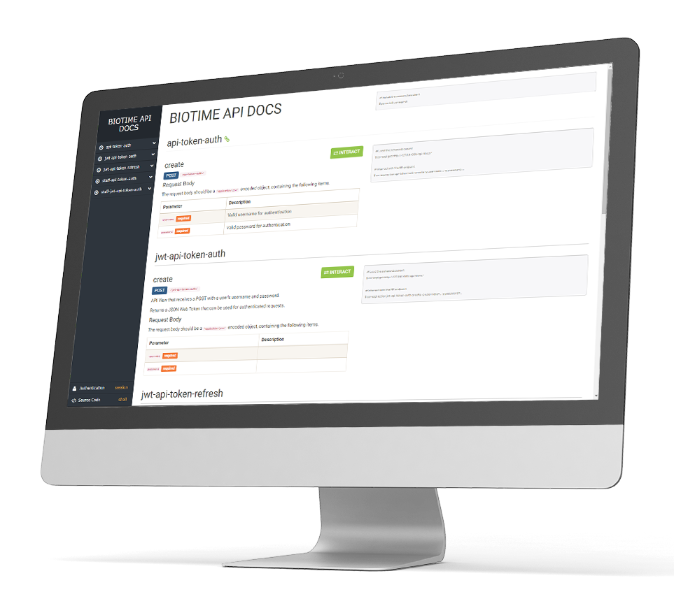
NEW
INTEGRATION WITH API
BioTime 8.5 has a standard API for third-party software integrations.

Slide 14

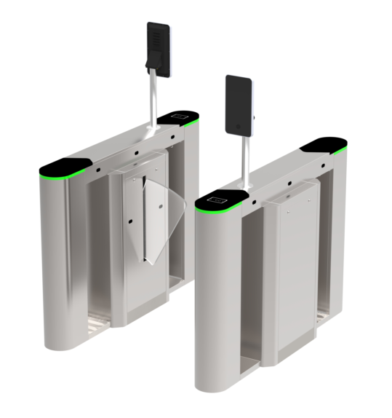
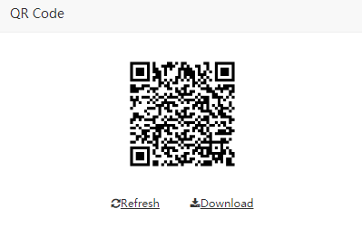
NEW
BIOPHOTO FUNCTION
BioPhoto function enables a user to register using his/her mobile phone.
1
2
3
Scan the QR code to access the registration process.
Register your face using your mobile phone.
Enter the perimeter by verifying your face.
Note: Bio Photo function works only with visible light facial terminals.

Slide 15
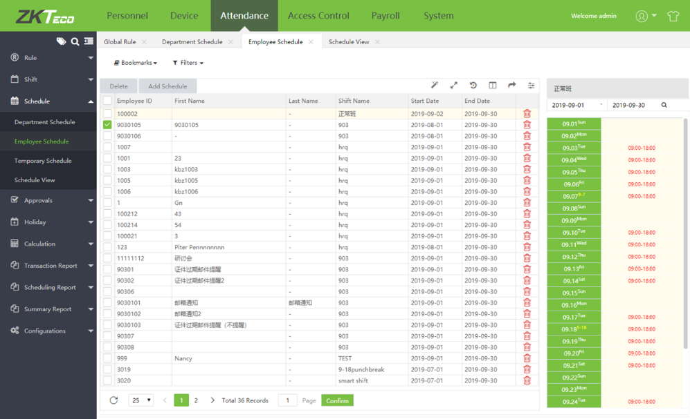
FLEXIBLE SHIFT SCHEDULING
Multiple timetable
Cross-day shift (24 hours)
Shift Cycle
Auto shift
Temporary schedule

Slide 16


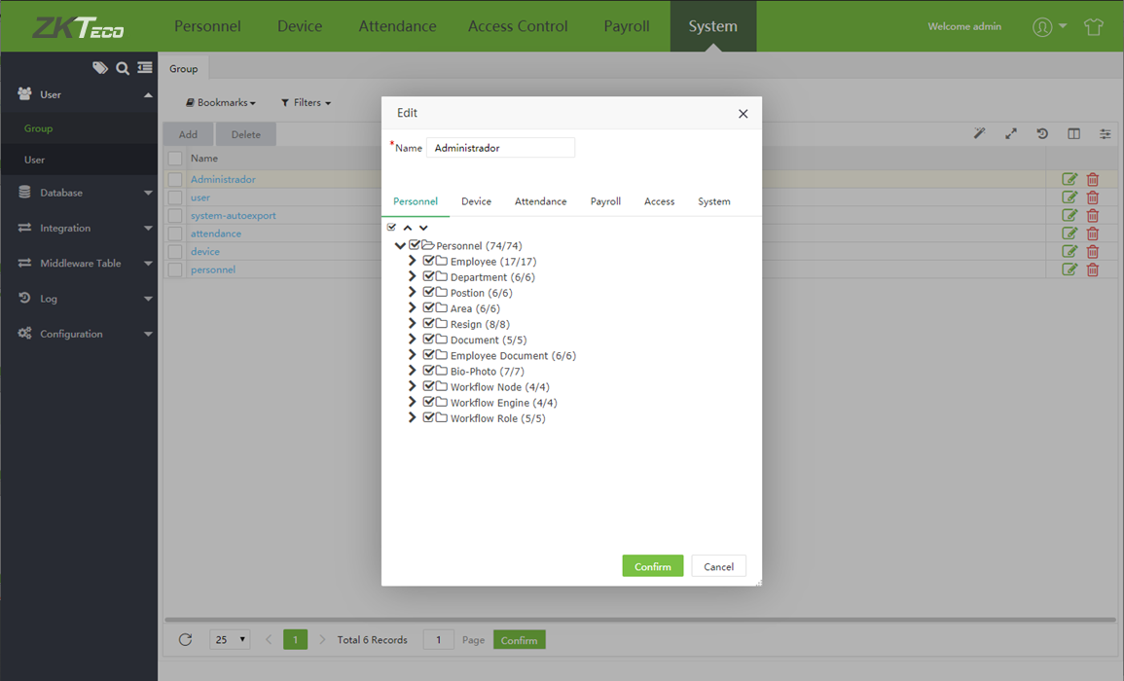
MULTIPLE
ADMINISTRATOR
PRIVILEGE
Multiple administrator can be set to manage different privileges in the software. Administrator will get a list of employee’s attendance including the number of late and absences.

Slide 17
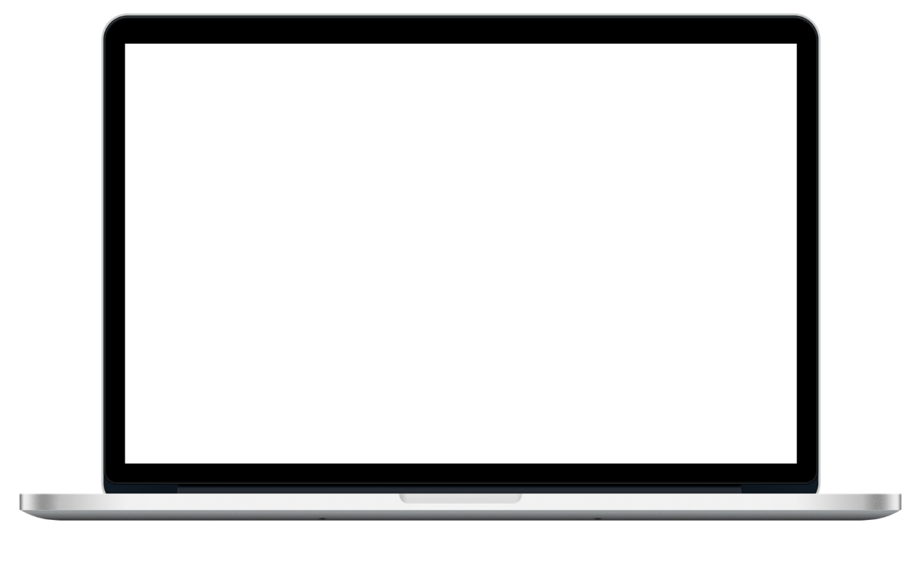
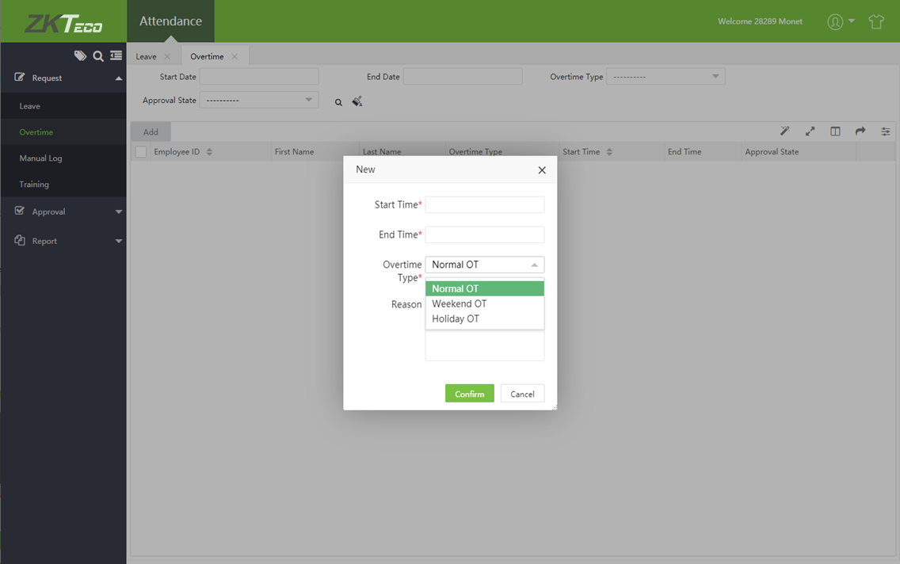
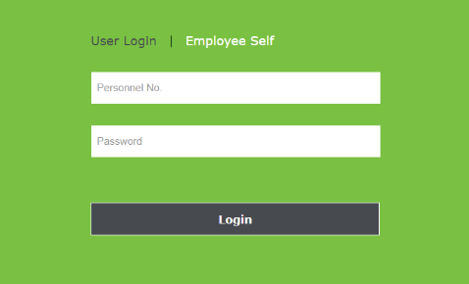
EMPLOYEE SELF-
SERVICE ENQUIRY
Access login is provided for each employees to check their attendance. Employees can apply for leave, training, manual punch, and change of schedule online to be approved by the manager or admin.

Slide 18
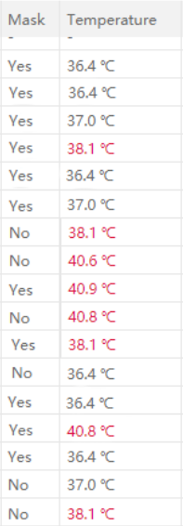

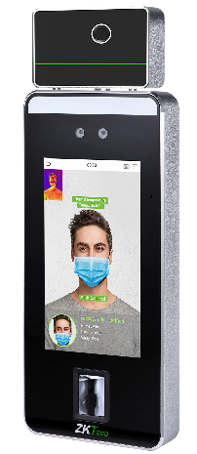
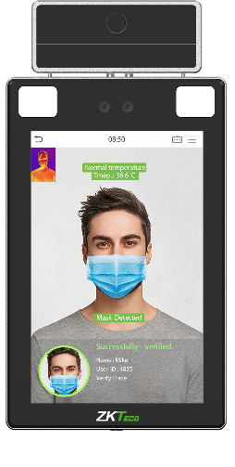
NEW
BODY TEMPERATURE AND MASK DETECTION
Displays the real-time logs including the body temperature detected in the device and if a user is wearing a mask or not.
Define the acceptable and normal body temperature in the software.
Supports ZKTeco’s time attendance and access control terminals with body temperature and mask detection function.

Slide 19
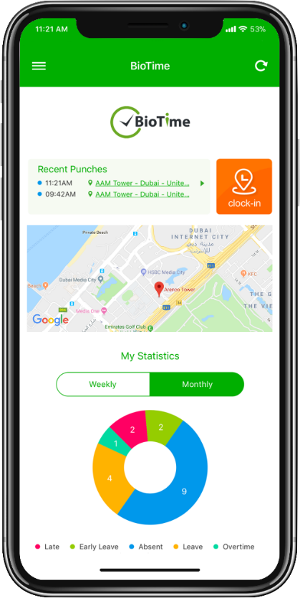
NEW
GEOFENCING MOBILE PUNCHES
Creates a geographic boundaries to restrict mobile application punches.
Clock-in Not Allowed
Clock-in Allowed
Clock-in Not Allowed

Slide 20
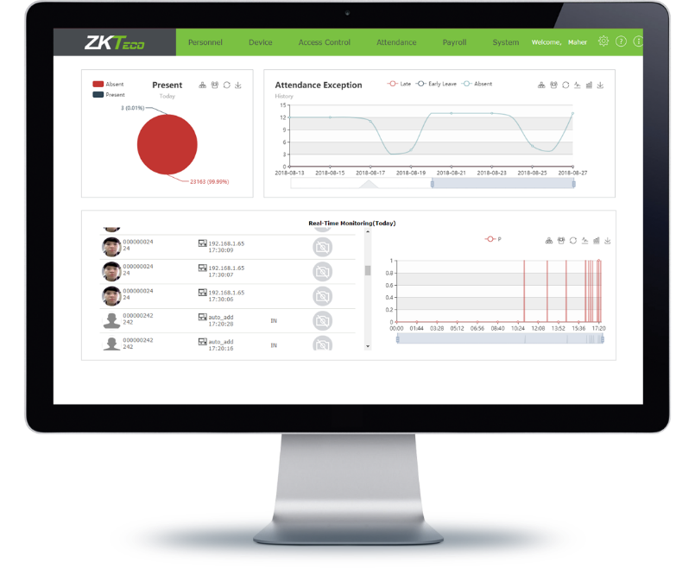
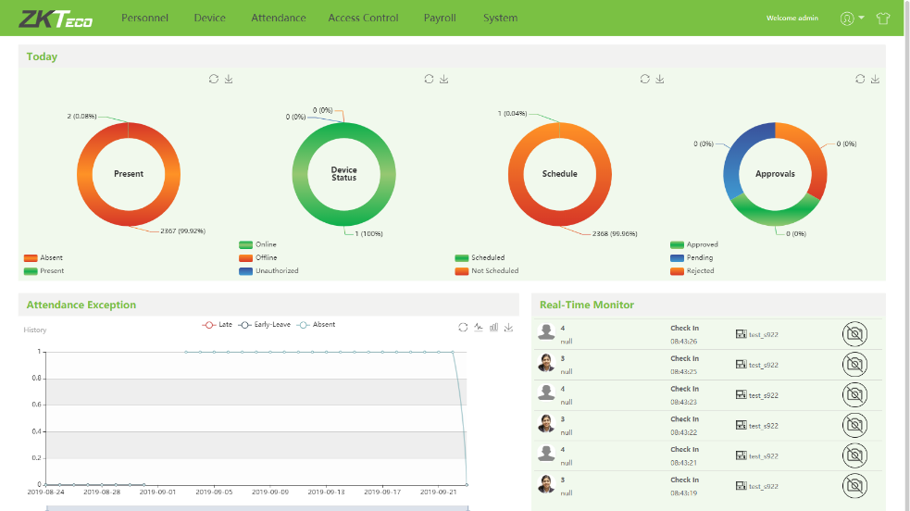
NEW
DATABASE MIGRATION
Allows the user to upgrade the software easily by inbuilt operation.
Migration
BioTime 8.5
Migrate from:
BioTime 7.0

Slide 21
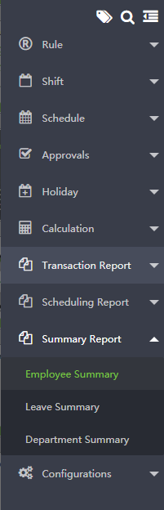
ATTENDANCE CALCULATION AND REPORTS
Generates up to 15 types of attendance reports that can be exported in CSV, PDF, or XLS format.

Slide 22

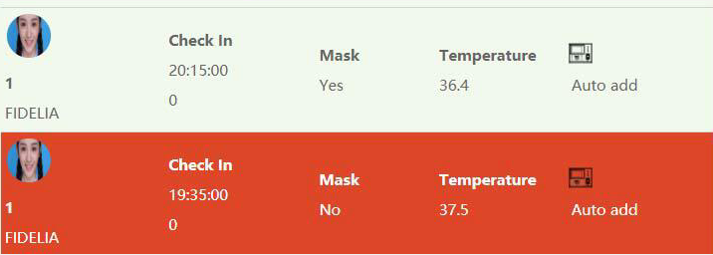
NEW DASHBOARD
Summary
Shows a summary of attendance, device
status, schedule, and approvals in the
current day.
Real-Time Monitoring
Shows the real-time attendance
logs whenever an employee
punches in or punches out. If enabled, it also shows the body temperature and mask detection logs.
Attendance Exception
Shows a graph of the previous statistics
of early leave, late, and absence.

Slide 23
SPECIFICATIONS
SOFTWARE SPECIFICATIONS
Templates | Fingerprint / Face / Palm / RFID / Password
System Architecture | Server/Browser
Device Capacity | 500 in a single server
Database | PostgreSQL (Default) / MySQL5.0.54 / MS SQL Server 2005/2008/2012/2014 / Oracle 10g/11g/12c
Operating System | Windows 8/8.1/10 / Windows Server 2003/2008/2012
Monitor Resolution | 1024*768 or above
HARDWARE REQUIREMENTS
Device | 100 | 200 | 500
System Architecture | Intel i3 Quad Core | Intel i5 / Magny-Cours | Intel i7 / Magny-Cours
RAM | 16GB | 32GB | 64GB
Storage | Available space of 100GB or above. (We recommend using NFTS hard disk partition as the software installation directory)
*If above 500 devices, please contact ZKTeco.
*It is recommended to use different server for database.

Slide 24
ZKBIOTIME Mobile Application
Features:
Real-time attendance with geographic location details
Attendance approvals
Real time notifications
Public and Private Announcements
Easy operation: Two-step navigation
User-friendly interfaces for admin and employees
Online employee requests and status

Slide 25
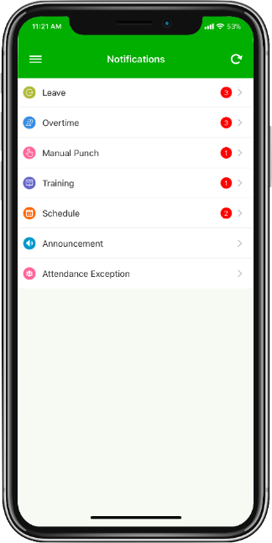
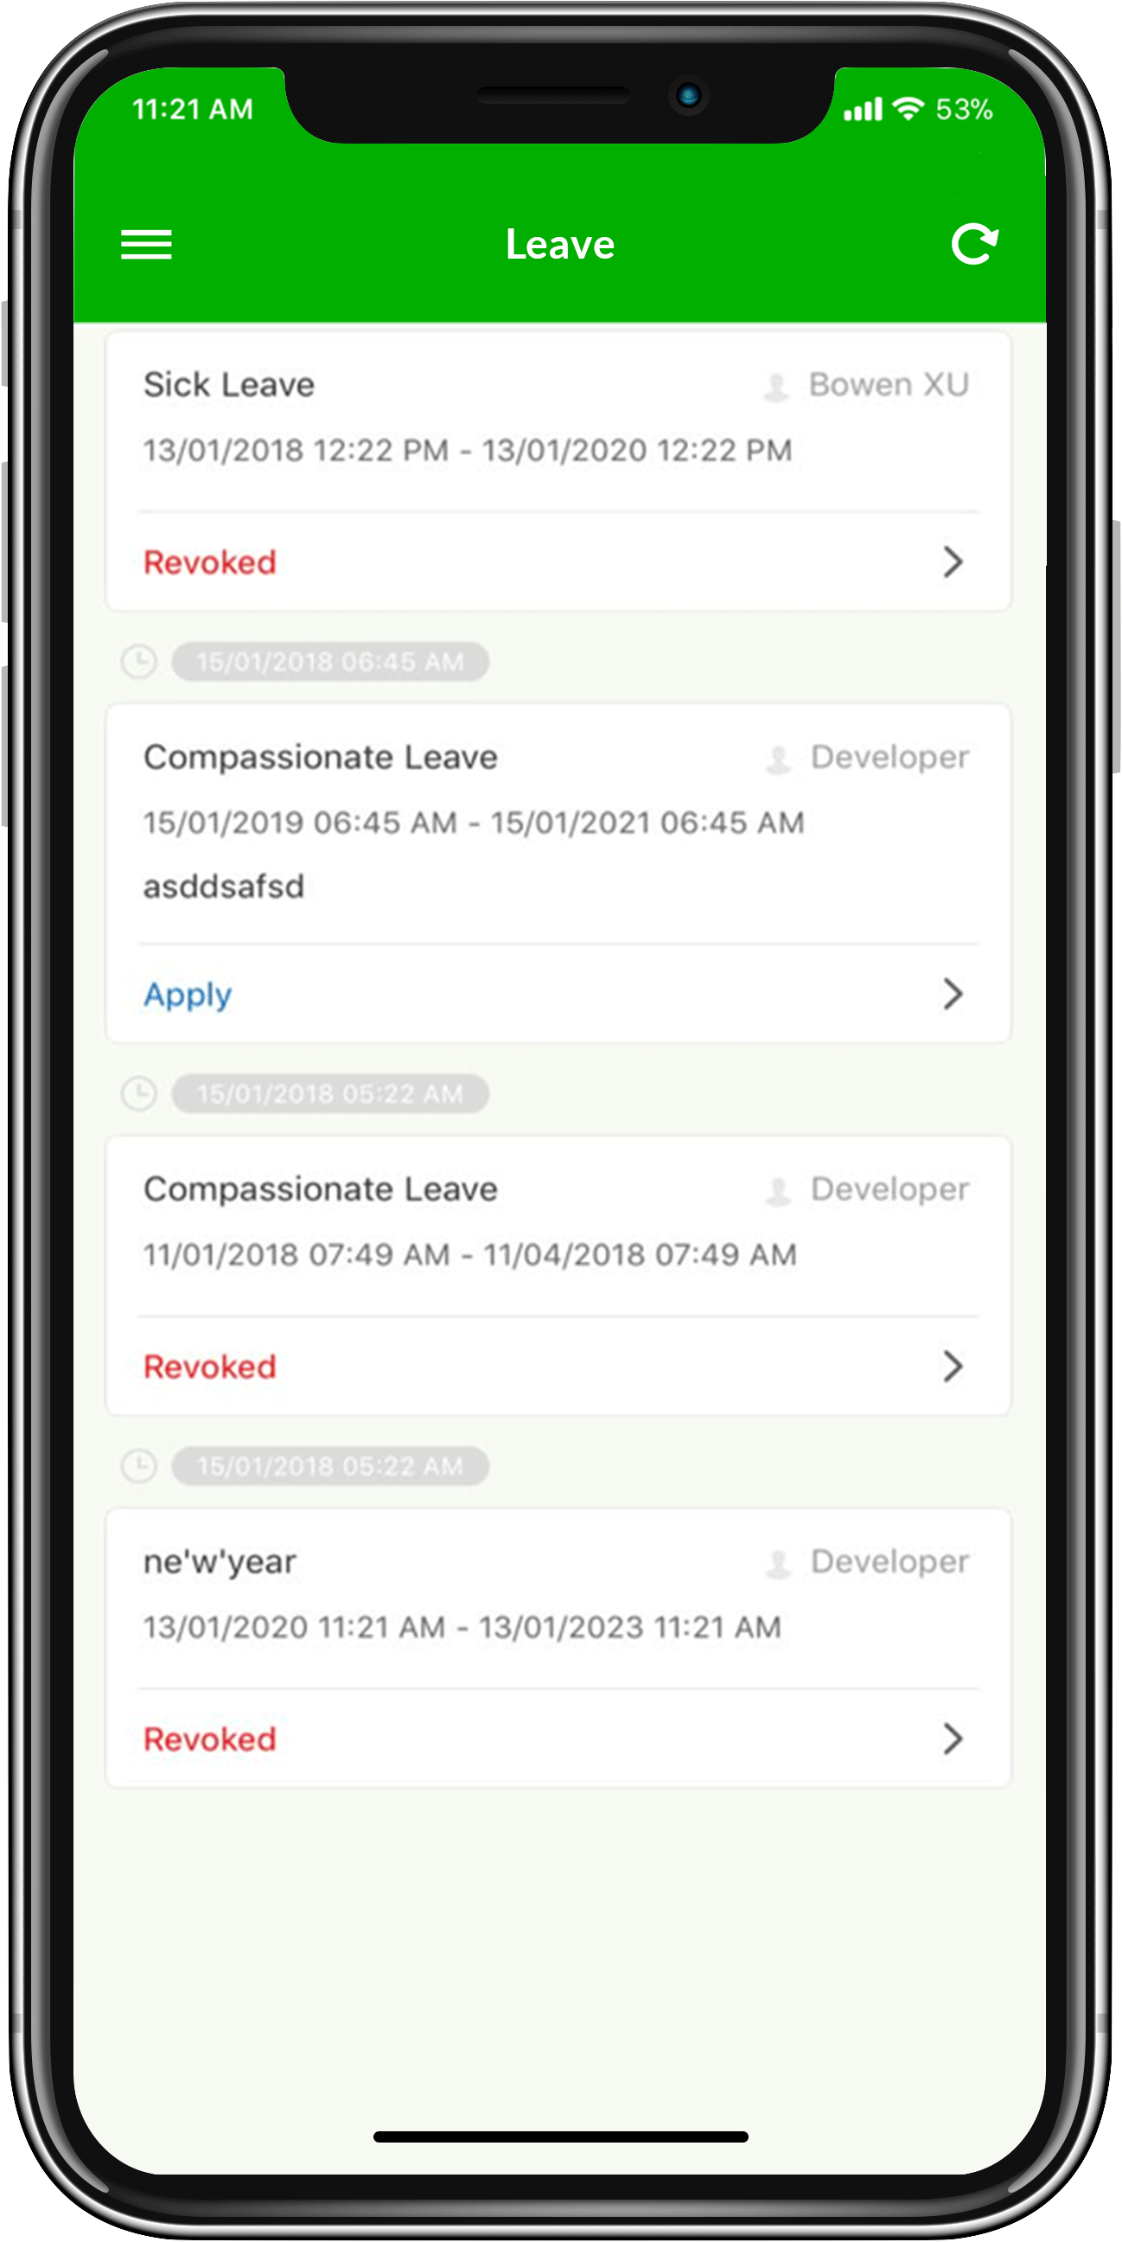
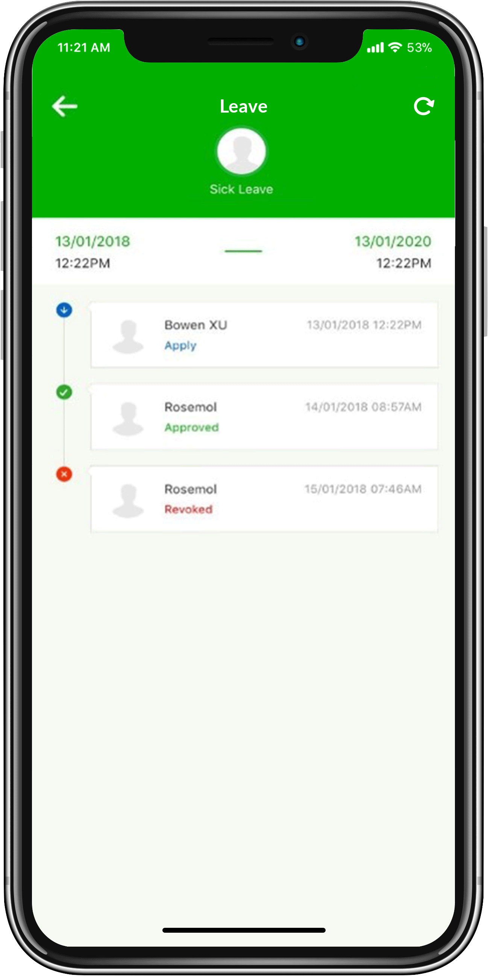
ONLINE NOTIFICATION
Interface provides easy access for employee requests
Displays the status in multi-level approvals

Slide 26
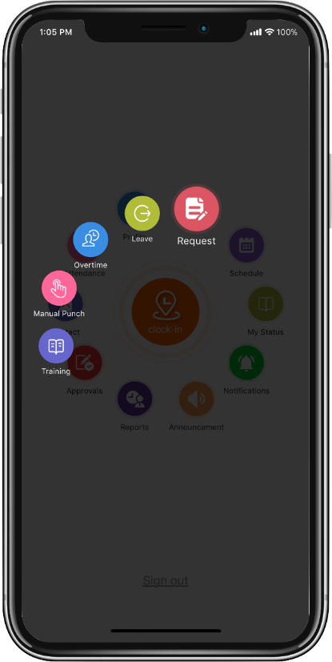
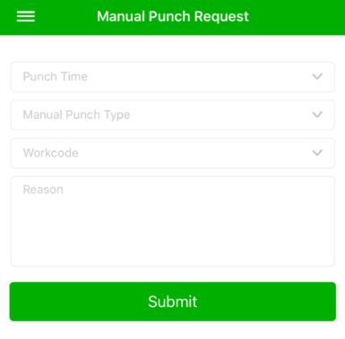
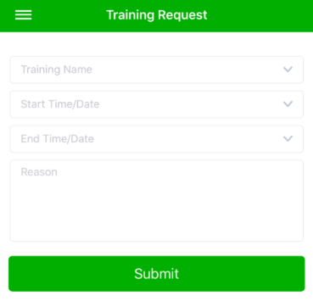
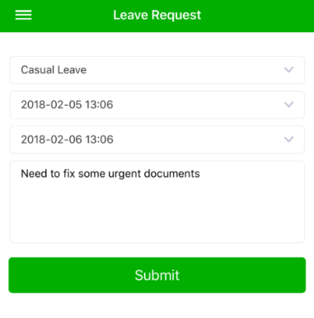
ONLINE REQUEST
Employees can apply for leave, training, overtime, and manual punch on “My Request” menu.
All requests will move to approval section which are to be approved by the Admin or Approver.

Slide 27
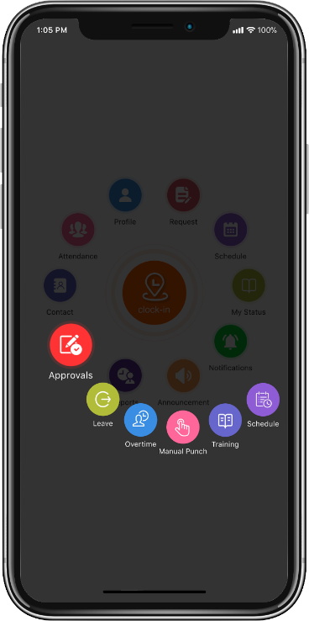
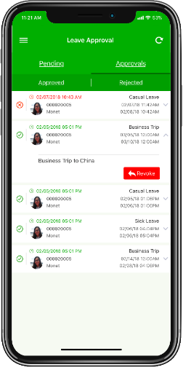
APPROVAL FLOW
Multi-level approvals for admin/approvers
Leave
Overtime
Manual Punch
Training
Schedule

Slide 28
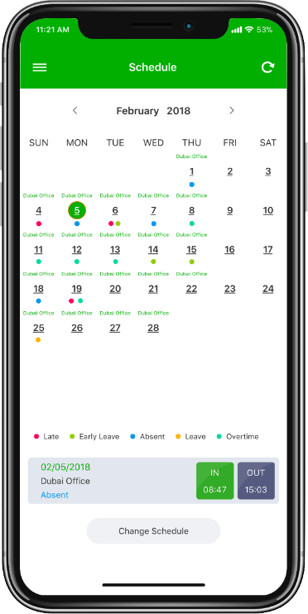
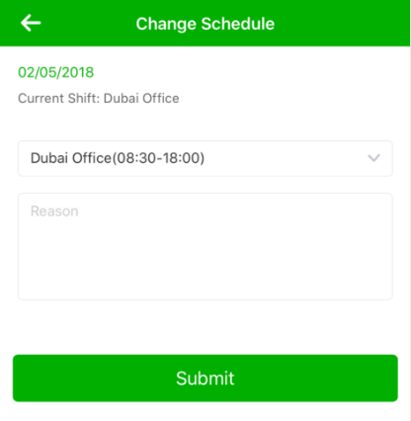
SCHEDULE ASSIGNMENT
ZKBioTime APP displays employee schedule from the BioTime main server.
Employee can change his/her assigned schedule that will be subjected by approval of Admin/Approver.

Slide 29





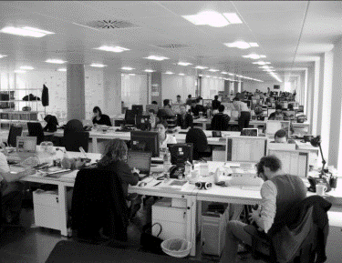
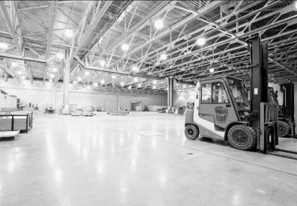
APPLICATIONS
Government
Schools & Universities
Construction Sites
Chain Stores
Clinics & Hospitals
Commercial Offices
Retail & Logistics

Slide 30

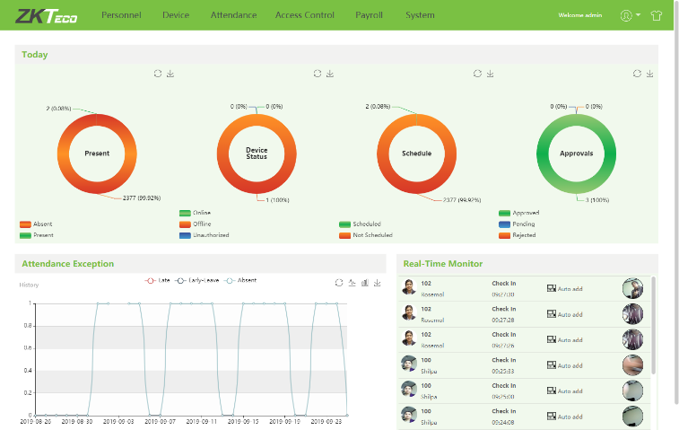



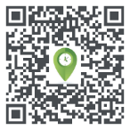
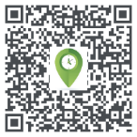
CLICK HERE
Mobile Application
or
Copy this on your web browser: http://biotimedxb.com:8085/
Software Package
Username: admin
Password: admin
CLICK HERE

Slide 31
THANK YOU
If you have any questions, you may reach us at
ZKTeco Middle East
P.O. Box 4323, Office 1207, Floor 112, Arenco Tower, Media City, Dubai, U.A.E.
Tel No.: +971 4 3927639 | +971 4 3927649
E-mail: zk_me@zkteco.com
www.zkteco.me
Updated: 18 September 2019

